Slide 1
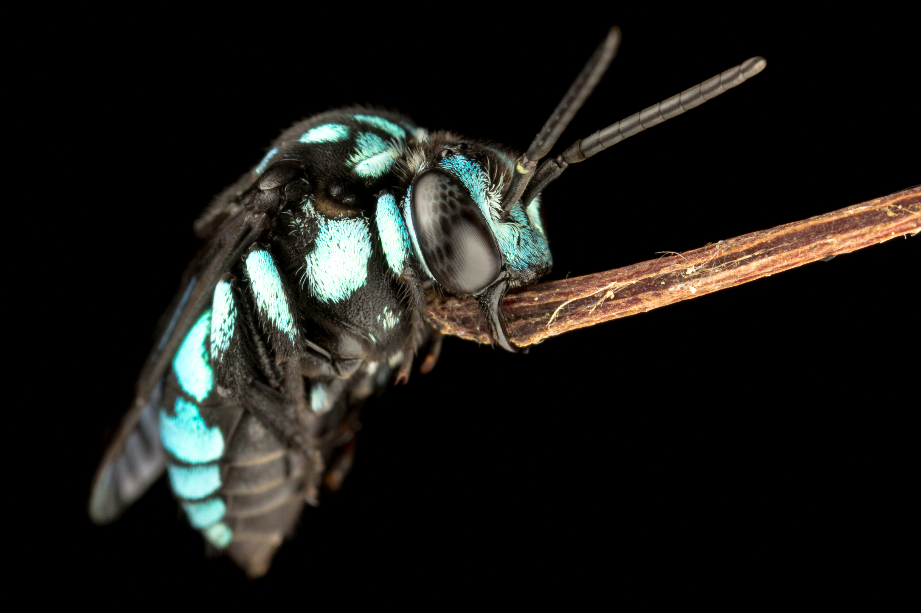
BIOL365: Marine and Terrestrial Ecology
Practical 5: Your phylogeny
James Dorey, Damien Esquerré, and Phil Byrne

Slide 2
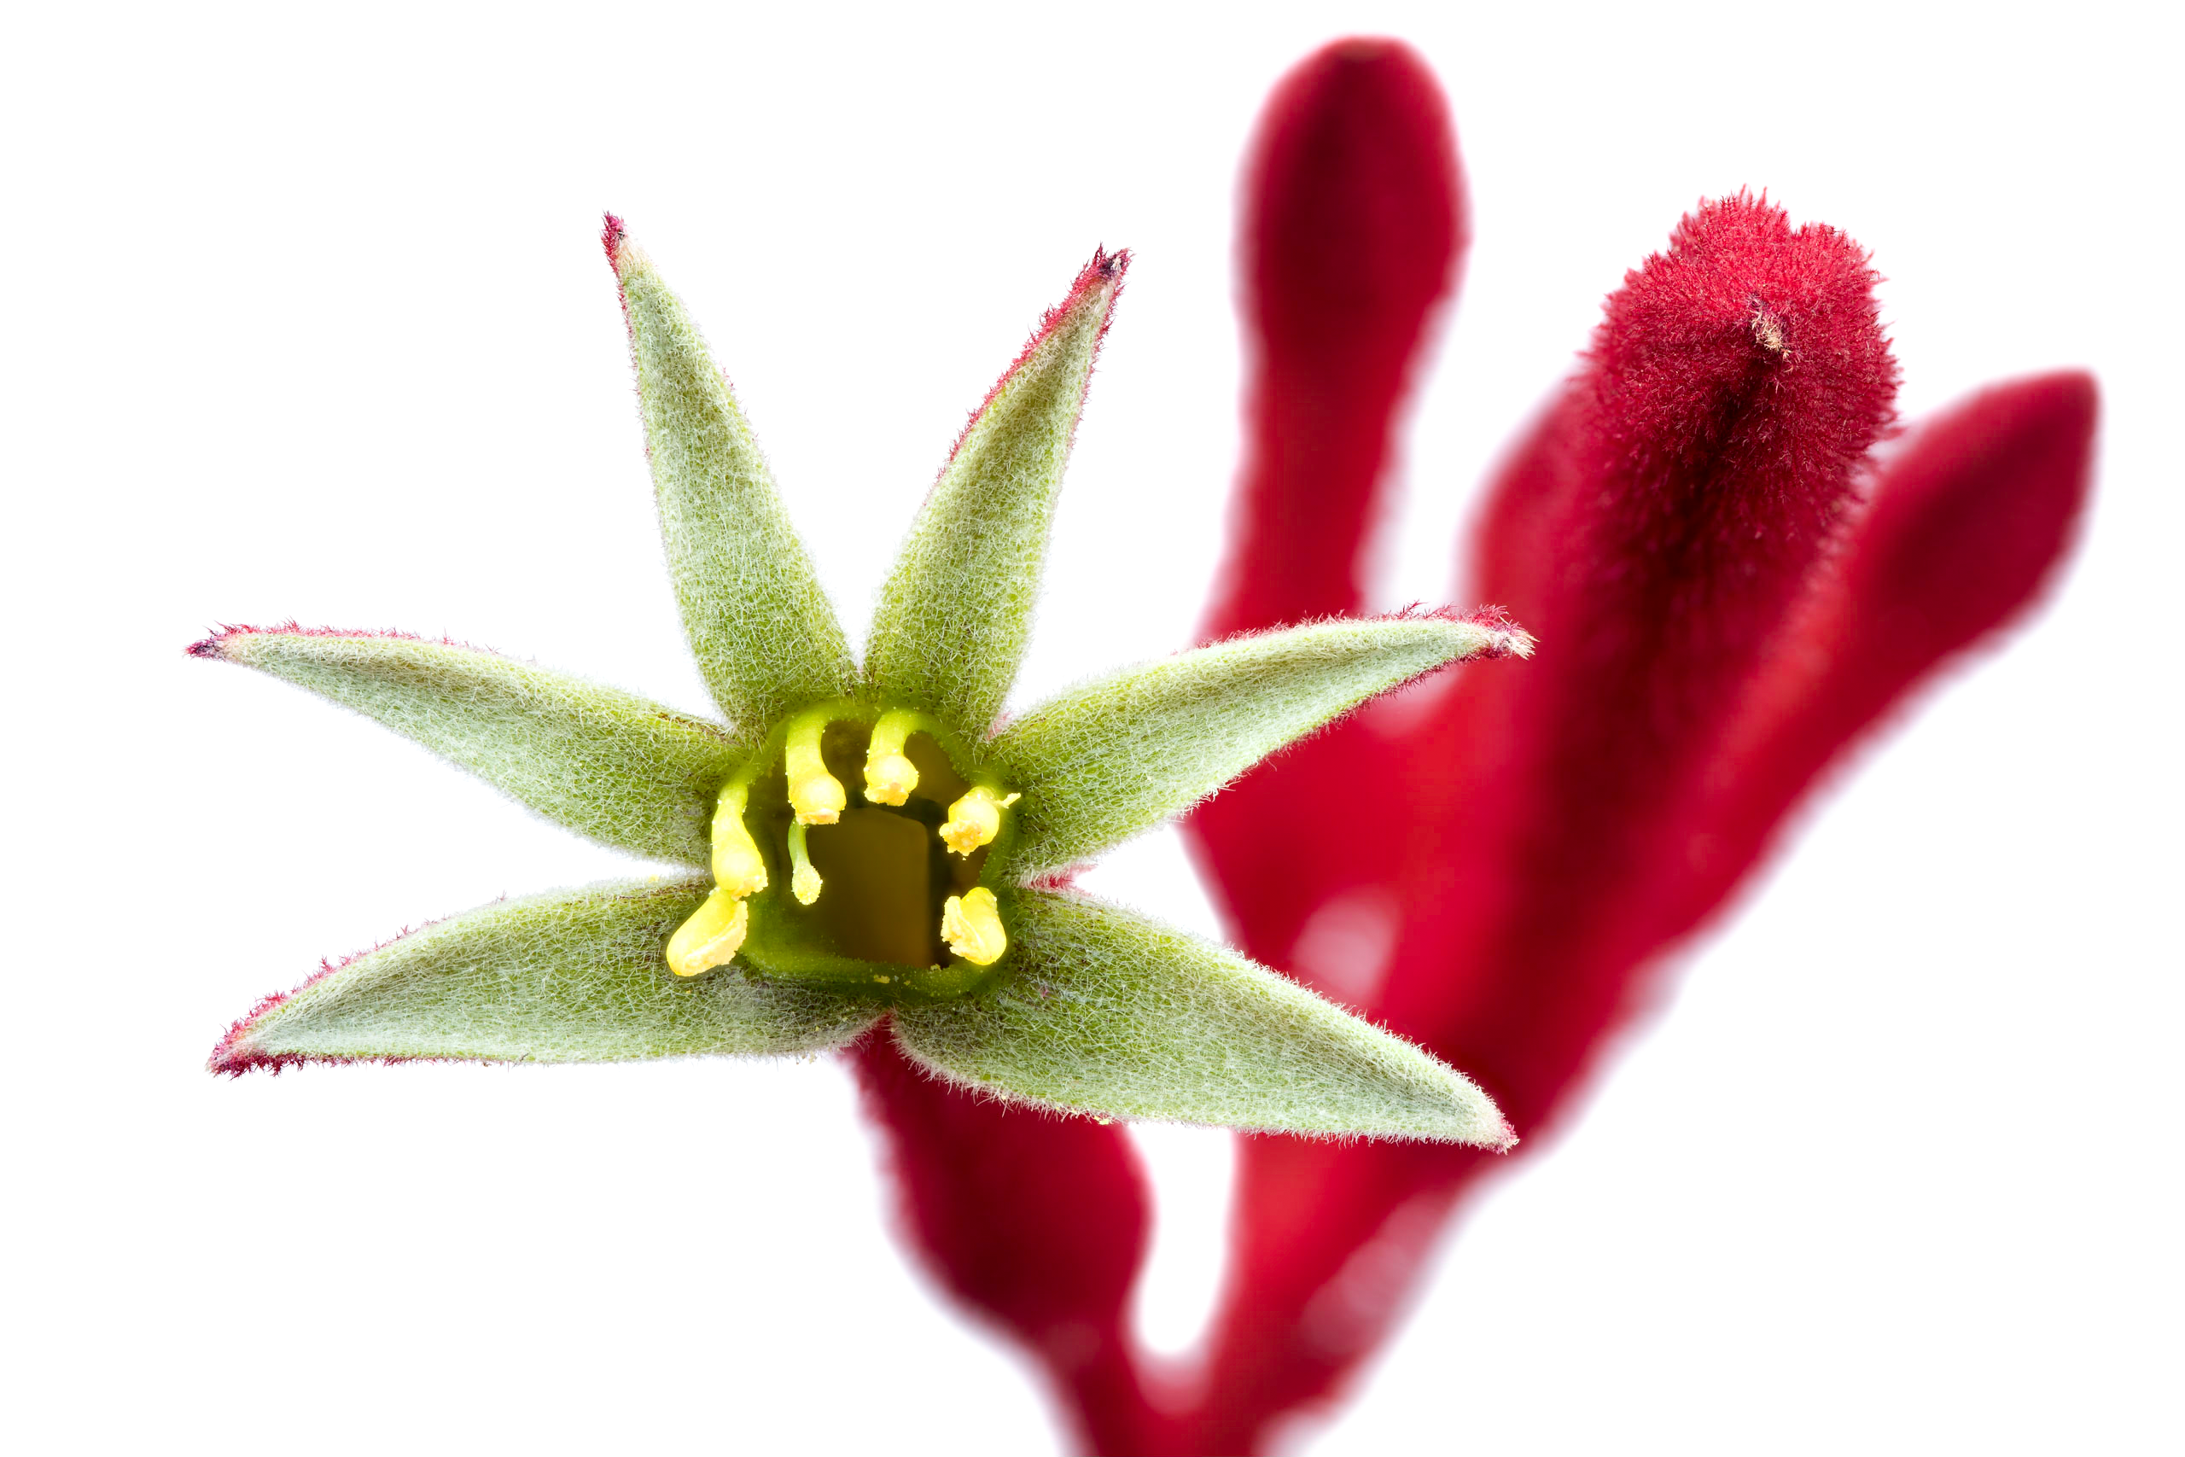
What to expect today
Initial guidance
Limited help with your assignment

Slide 3
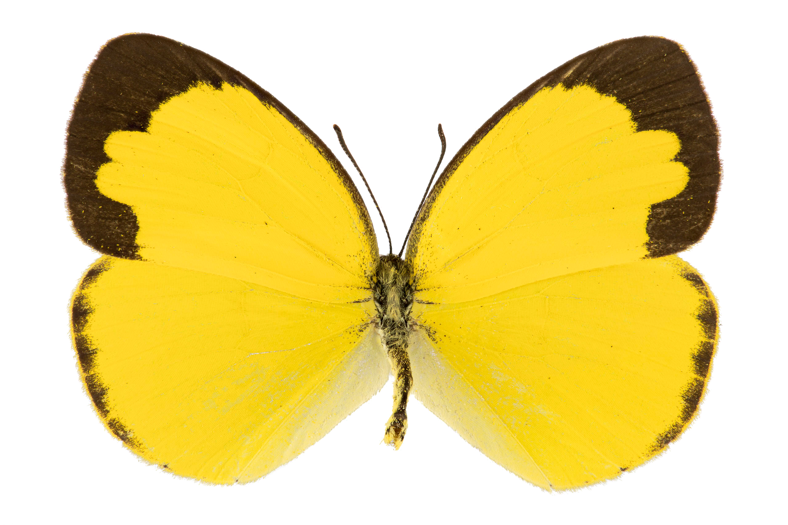
Initial guidance
Statistics
Might make it easier to talk about your assignment
Length
Only as long as you need
Components
Phylogeny + outgroup
Inferred trait evolution
Description of evolution (1–2 paragraphs)
References, Genbank numbers, and R code

Slide 4
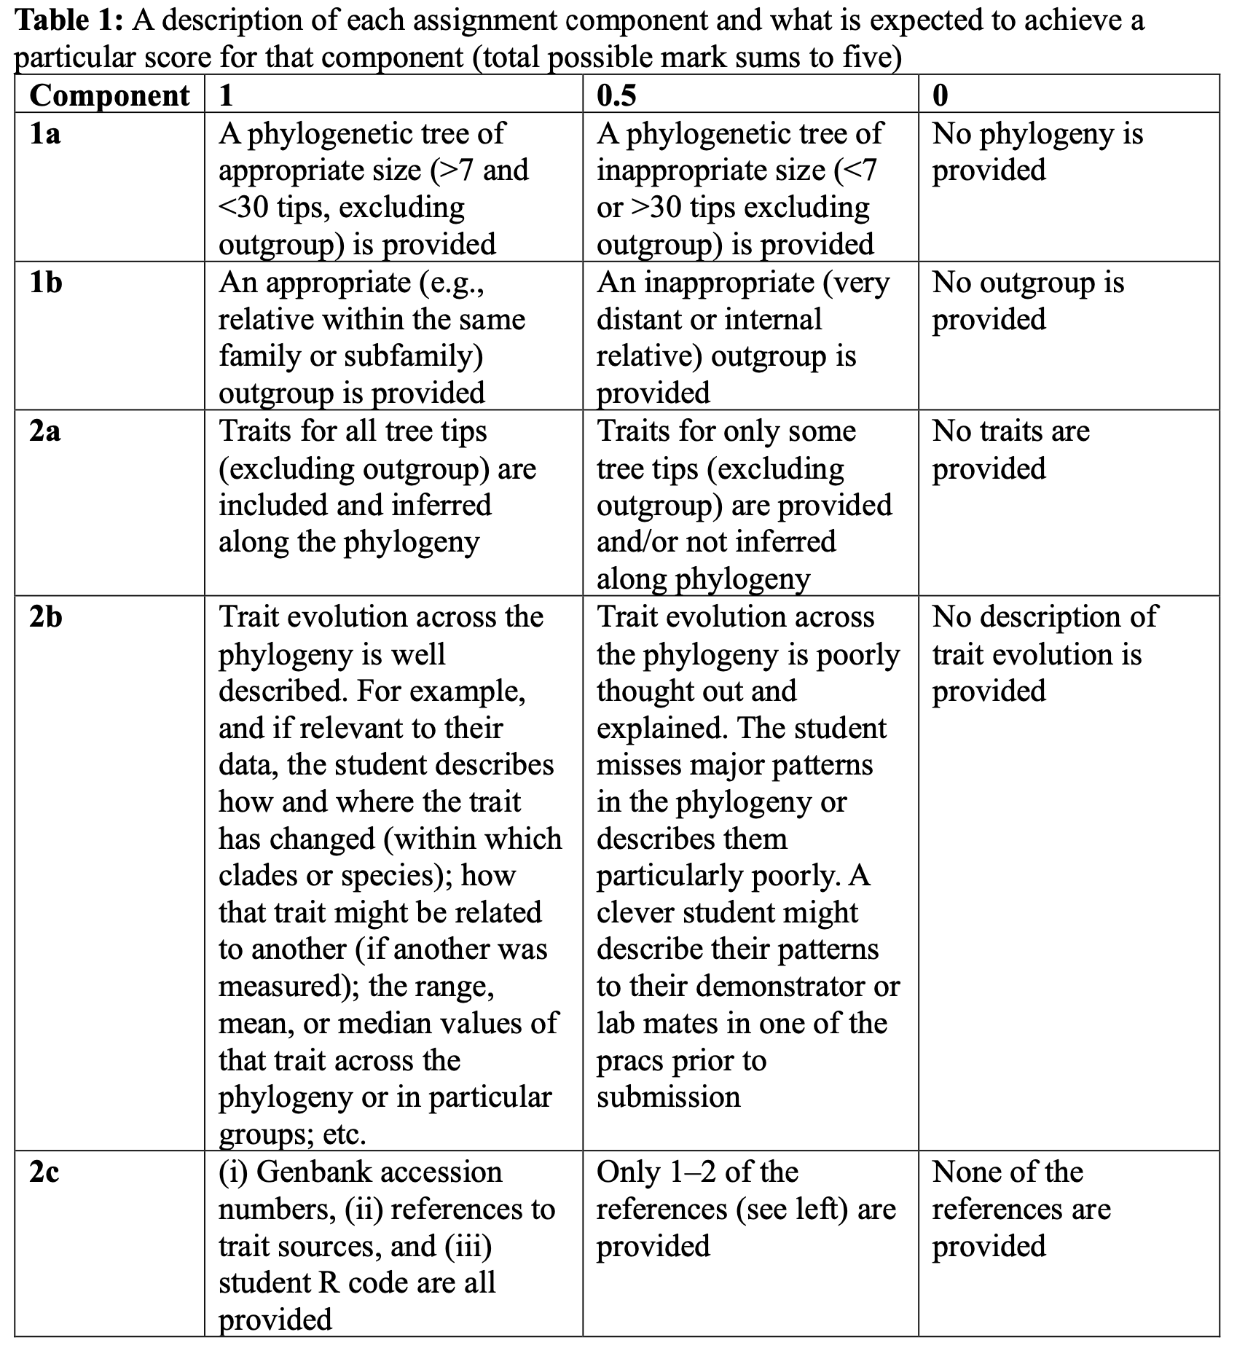
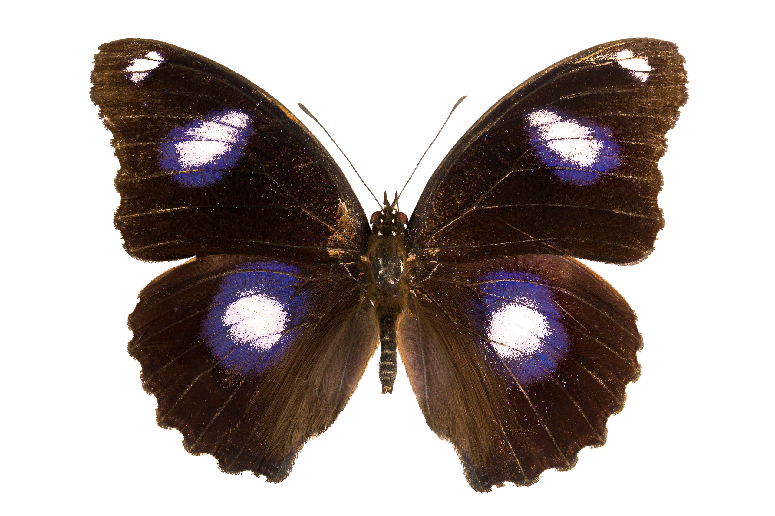
Initial guidance
Rubric
We tell you EXACTLY what you need for full marks
Full guidelines and rubric on Moodle since Week 1
Rubric at end of your Prac 4 manual as well

Slide 5
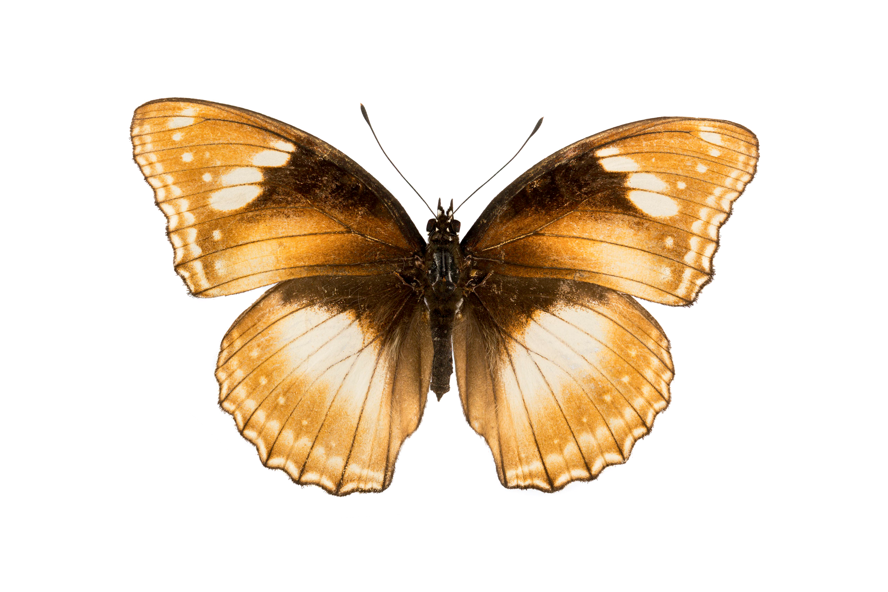
Part B; a foreword
Rubric has also been up since Week 1
This is more based on the science (less so coding)
Grant writing — can be difficult, but is very important
You will NEED to think and use literature to justify asking for money
Justifications:
Blue-sky reasons (easier; follow up research, etc.)
Importance to Australia — or the country your taxa are found in. This is harder, but you’re a third year and you can do this and we want to challenge you
*Rubric does not specify that you need to use the same phylogeny for part a and b

Slide 6
Did you finish early?
Help your neighbour
Work on your assignment and seek help or advice (keeping in mind that others doing the Prac might need more help)
???
Okay, fine you can go if you’ve checked with your demonstrator

